Slide 1
Opening of School Preparations Federal and State Compliance
Wanda Thomas, Sr. Manager
Tuesday, August 9, 2022
Wednesday, August 10, 2022

Slide 2
Introductions
Dr. Allison Matney, Executive Officer, Research and Accountability
Roshunda RobertsJackson, Executive Director, Federal and State Compliance
Wanda D. Thomas, Senior Manager FSC
Agenda:
8:30-11:00 AM - Morning Session
Federal and State Compliance and State Reporting
11:00 AM – 12:00 PM - Lunch
12:10 PM – 4:00 PM Afternoon Breakout Sessions
Early Childhood
Federal and State Compliance
Health and Medical Services
Migrant Programs
Multilingual Department
Office of School Choice
State Reporting
Student Assistance
Student Enrollment
Student Records
School Registrars Special Session

Slide 3
FEDERAL AND STATE COMPLIANCE DEPARTMENT RESPONSIBILITIES
Data Monitoring and Problem Identification
Monitor data related to funding eligibility, accreditation, and compliance to determine that appropriate documentation is being maintained and to identify discrepancies, errors, or omissions of data that impact these issues. Monitor specialized student-related reporting such as discipline, dropouts, Student Success Initiative, etc. to ensure compliance with all reporting specifications.
Data Quality
Improve the quality of student data which impacts funding, accreditation and compliance through increased extensive, on-site campus monitoring. Interface with HISD departments to get input on required documentation for their area of responsibility and identify potential data problems in that area. Implement or initiate standard procedures to verify that student data meets all state requirements. Train and monitor school staff in this process.

Slide 4
COMPLIANCE MONITORING TEAM
This team reviews manual / data for Discipline and PEIMS Leavers/Dropouts, collaborates with special populations departments to ensure data integrity, conducts training and assists the State Reporting Team by overseeing the campus data correction process. In addition, they manage four Sr. Student Information Representatives.
Email | Senior Compliance Analyst | Sr. Student Information Rep
Craig.Zeno@houstonisd.org | Craig Zeno | Berta Garcia/Lisa Shannon/Valencia Semien
lsmith3@houstonisd.org | Latonya Smith | Alma Salazar, Dachundralyn Palmer, Glennedo Hurts
TBA | Vacancy | Rachel Betancourt/Felicia Freeman/Rose Fuentes/Nina Grant

Slide 5
SENIOR STUDENT INFORMATION REPRESENTATIVES
This team monitors official ADA attendance, reviews ADA and OFSDP attendance by 6-week period to ensure the data is accurate, maintains attendance accounting records, reconciles student membership and absences and monitors campus PEIMS data to ensure compliance with TEA requirements
Email | Sr. SIR |  | Email | Sr. SIR
rbetanc2@houstonisd.org | Rachel Betancourt |  | Glennedo.Hurts@houstonisd.org | Glennedo Hurts
rfuentes@houstond.org | Rose Fuentes |  | dpalmer@houstonisd.org | Dachundralyn Palmer
ffreeman@houstonisd.org | Felicia Freeman |  | Alma.Salazar@houstonisd.org | Alma Salazar
bgarcia3@houstonisd.org | Berta Garcia |  | lshanno1@houstonisd.org | Lisa Shannon
ngrant2@houstonisd.org | Nina Grant |  | vsemien@houstonisd.org | Valencia Semien

Slide 6
TSDS PEIMS STATE REPORTING TEAM
This team works with the Sr. Compliance Analysts and Sr. Student Information Representatives to ensure that TSDS PEIMS data is accurate and that all data requests are fulfilled in an accurate and timely manner.
Name | Phone | Email
Irma Hasnain, Sr. Manager, State Report | 713-556-6759 | ihasnain@houstonisd.org
Nancy FigueroaTorres, Sr. Compliance Analyst | 713-556-6767 | Nancy.FigueroaTorres@houstonisd.org
Marina Tejada, Sr. Compliance Analyst | 713-556-6768 | mtejada@houstonisd.org
Tori Sombright, Sr. Compliance Analyst | 713-556-8813 | Tori.Sombright@houstonisd.org
Sylvia Guerrero, Student Information and Reporting Analyst | 713-556-6773 | Sylvia.Guerrero@houstonisd.org
Rose Gamboa, Sr. Student Information Rep | 713-556-6753 | rgamboa@houstonisd.org

Slide 7
Objectives
Participants will be provided with an overview of Opening School Day Procedures:
Enrollment
Membership
Attendance
TSDS Unique ID
Scheduling
Student Records
Special Populations
Health and Medical Information

Slide 8
DATA INTEGRITY
Attendance clerks, data entry clerks and SIR’s play an essential role in HISD’s efforts to ensure that all data is timely, accurate and properly documented.
In no case should paraprofessional personnel be responsible for determining students coding information for attendance, program placement or special services.

Slide 9
DATA INTEGRITY
Consequences for inaccurate records:
- Lowering of HISD’s accountability record
- Lowering of a school’s accountability rating
- Loss of funds to HISD which could impact jobs, salaries, and programs for students
- Students may be retained inappropriately
- Reprimands from the state

Slide 10
DATA INTEGRITY
Security Access
- You must not give your passwords to others
- You must always prevent unauthorized
access from your computer when you are
away from your desk
- You must not accept the password from
others

Slide 11
Taking and Recording Student Attendance
It is your district's responsibility to ensure that the basis used to record and process attendance accounting data meets the standard set forth in the Student Attendance Accounting Handbook.
District personnel must create the original documentation of attendance at the time of attendance. Original documentation may not be created after the fact. Original documentation that is not created at the time of attendance will not be accepted by agency auditors. If auditors determine that original documentation was not created at the time of the attendance it is intended to support, the TEA will retain 100% of your district's FSP allotment for the inappropriately documented attendance for the school year(s) for which records have been requested. The TEA will either assess an adjustment to subsequent allocations of state funds or require your district to refund the total amount of the adjustment when the audit is finalized.
19 TAC §129.21(f) and §129.1025

Slide 12
The Family Educational Rights and Privacy Act (FERPA)
The Family Educational Rights and Privacy Act (FERPA) (20 U.S.C. § 1232g; 34 CFR Part 99) is a Federal law that protects the privacy of student education records. The law applies to all schools that receive funds under an applicable program of the U.S. Department of Education.
FERPA gives parents certain rights with respect to their children's education records. These rights transfer to the student when he or she reaches the age of 18 or attends a school beyond the high school level. Students to whom the rights have transferred are "eligible students."
Parents or eligible students have the right to inspect and review the student's education records maintained by the school. Schools are not required to provide copies of records unless, for reasons such as great distance, it is impossible for parents or eligible students to review the records. Schools may charge a fee for copies.
Parents or eligible students have the right to request that a school correct records which they believe to be inaccurate or misleading. If the school decides not to amend the record, the parent or eligible student then has the right to a formal hearing. After the hearing, if the school still decides not to amend the record, the parent or eligible student has the right to place a statement with the record setting forth his or her view about the contested information.

Slide 13
The Family Educational Rights and Privacy Act (FERPA)
Generally, schools must have written permission from the parent or eligible student in order to release any information from a student's education record. However, FERPA allows schools to disclose those records, without consent, to the following parties or under the following conditions (34 CFR § 99.31):
School officials with legitimate educational interest;
Other schools to which a student is transferring;
Specified officials for audit or evaluation purposes;
Appropriate parties in connection with financial aid to a student;
Organizations conducting certain studies for or on behalf of the school;
Accrediting organizations;
To comply with a judicial order or lawfully issued subpoena;
Appropriate officials in cases of health and safety emergencies; and
State and local authorities, within a juvenile justice system, pursuant to specific State law.

Slide 14
The Family Educational Rights and Privacy Act (FERPA)
Schools may disclose, without consent, "directory" information such as a student's name, address, telephone number, date and place of birth, honors and awards, and dates of attendance. However, schools must tell parents and eligible students about directory information and allow parents and eligible students a reasonable amount of time to request that the school not disclose directory information about them. Schools must notify parents and eligible students annually of their rights under FERPA. The actual means of notification (special letter, inclusion in a PTA bulletin, student handbook, or newspaper article) is left to the discretion of each school.

Slide 15
HISD DATA QUALITY 2022-2023 Guidelines and Resources
Solution Center Site Page for HISD Connect (HISD Employee Portal)
Project SIS News Line (via email)
Academic Service Memos (HISD Employee Portal)
Federal and State Compliance Website
HISD Board Policy (HISD Website)
HISD Guidelines (FSC Website)
TEA Student Attendance Accounting Handbook
(TEA Website)
TEAL (TEA Website)
TWEDS (TSDS Web-Enabled Data Standards)

Slide 16
OPENING OF SCHOOL PREPARATIONS PACKET District Calendar & Dates
HISD Academic Calendar
Important Dates
Report Card/Progress Report Dates
Grade Reporting Dates
UIL Eligibility Dates

Slide 17
OPENING OF SCHOOL PREPARATIONS PACKET Academic Memos & Project SIS News Line Emails
Release of Students in PowerSchool SIS for Enrollment in Other Schools
Membership Reporting for 2022-2023
No Show Process
Project Newsline - HISD Connect Start of School 2022-2023

Slide 18
OPENING OF SCHOOL PREPARATIONS PACKET DOCUMENTS
Opening of Schools Agenda
Academic Calendars and Important Dates
Memos
FSC Contact List, 2022-2023
HISD SIS Access Request Form
Membership Reporting in HISD Connect
Request Access for Membership in HISD Connect
HISD Student Attendance Accounting Handbook Information
ADA Exemptions
Attendance Codes in HISD Connect School
Attendance Best Practices
Helpful Opening of School Tips
Important Enrollment Steps
PK Funding Codes
At-Risk Criteria

Slide 19
OPENING OF SCHOOL PREPARATIONS PACKET SAMPLE FORMS
Age Formula Calculation Chart (FSC Website)
First Day Membership Form
ADA Attendance Change Form Elementary (FSC Website)
ADA Attendance Change Form Secondary (FSC Website)
Daily Attendance Change Form (FSC Website)
Period Attendance Change Form (FSC Website)
Attendance Corrected by the Classroom Teacher within 24-hours
Teacher Grade Change Form (FSC Website)
Formal Request to Repeat A Grade for 2022-2023 PK-3rd Grade Only
Substitute Roster (HISD Connect)
Student Demographic Change Form (FSC Website)
Student Assistance Questionnaire (SRQ) (English & Spanish)
HISD Safety Acknowledgment Form (English & Spanish)
FSC Fall Training Schedule

Slide 20
OPENING OF SCHOOL PREPARATIONS PACKET
HISD Elementary & Secondary Schools
Alpha & Numerical Listings
Resources
Federal and State Compliance Website (https://www.houstonisd.org/Domain/8334)
Houston ISD School Guidelines located on the Federal and State Compliance Website
Houston ISD Board Policy located at Houstonisd.org
Early Childhood (http://www.houstonisd.org/Domain/8053)
IT Security and Access Forms https://houstonisd.sharepoint.com/sites/DEPTS/InfoTech/SitePages/ITForms.aspx
SIS Training Website (https://connect.houstonisd.org/IT/SitePages/SIS%20Training.aspx)
Frequently Requested Forms (https://www.houstonisd.org/parentforms)
Discipline Forms (http://www.houstonisd.org/Page/61625)
Leaver Forms (http://www.houstonisd.org/Page/68125)
2022-2023 Student Attendance Accounting Handbook located on the TEA Website https://tea.texas.gov/sites/default/files/saah2223-proposed.pdf
TEAL (https://tealprod.tea.state.tx.us/)

Slide 21
Tasks Prior to First Day of School
Post rosters throughout campus for parents to review.
Review the updated Membership Reporting procedures and the school district calendars.
Distribute Class Rosters to teachers with written instructions on how to document “no show” students.
Generate a list of students with no homeroom number (if applicable) or schedule and verify status.
Verify that ADA time is posted in your school.
Obtain Access to:
HISD Connect
Membership in HISD Connect
TSDS Unique ID
TREx

Slide 22
Tips to Ensure Successful First Day Counts
For first day counts to be successful, there will need to be staff members available to assist in all areas that include registration, withdrawing, schedule data entry, and assisting students to their classrooms/locations.
Establish a system to hand out student schedules.
Some campuses choose to print their first day schedules on colored paper. This will help with identifying your no-show students.
Make sure no one is printing extra student schedules for any reason.
If a student loses their schedule and there must be a re-print, have a system in place to ensure the original was picked up and print a replacement copy for the student.

Slide 23
Steps to Ensure Successful First Day Counts
Step 1 –
FREEZE ALL ACTIVITY
No student should be in transition during this period. All students MUST be with a teacher, administrator, or other staff member during the enrollment verification process.
Every teacher with a Classroom Roster will follow specific steps for validating his/her roster which includes adding new students to the bottom of their roster and marking a line through those students that are not physically present in the classroom (example included in packet).
Any administrator or staff member who is supervising students will use the 1st Day Students Pending Schedule Form. Staff must enter student’s names, ID numbers, and grade level, once completed, return to the attendance/registrar’s office (whichever is applicable to your campus). This includes students in the cafeteria, library, dean’s/counselor’s office, etc. or any student waiting to receive a schedule.

Slide 24
Steps to Ensure Successful First Day Counts
Step 2 – ACCOUNT FOR ALL STUDENTS
Have staff members collect all forms from the classrooms, those faculty members will also do a headcount to do a double check on the teachers count to ensure the count is accurate. The verifier must also sign that the number of students physically sitting in class matches what the teacher has recorded. Counts must be recorded by grade level.
There is to be no attendance taken in HISD Connect on the 1st day of school and no tardies.
New students who arrive with a new schedule must be written on the bottom of the roster.
Students on the roster, but not in class, should have one line drawn through their name and NS for “No Show” marked beside it.
All rosters and lists will be tallied by grade level and given to the SIR/Registrar. The SIR/Registrar will have Campus Principal/PEIMS Coordinator verify and sign First Day Count Tally Sheet.

Slide 25
Steps to Ensure Successful First Day Counts
Step 3 – RECONCILE THE COUNTS
All Classroom Rosters and 1st Day Students Pending Schedule Form must be sent to the SIR/Registrar.
SIR/Registrar will delete the schedule and withdraw All (No Show) students in HISD Connect by Close of Business on the First Day of School.
The number of enrolled students plus all newly enrolled students (unscheduled) minus the No show students should equal the physical count of students. (See 1st Day Counts form).

Slide 26
No Show Procedures for the Attendance Office
ALL STUDENTS NOT PHYSICALLLY PRESENT ON THE FIRST DAY OF SCHOOL MUST BE MARKED AS A NO SHOW
No-Show status should be used only after school starts.
The official No-Show date for all schools is 8/22/2022 and should be entered only for students who are enrolled, but not in attendance on the first day of school.
Unclaimed schedules must be retrieved and posted as No-Shows (Secondary Only)
All No-Shows must be posted by the end of the 1st Day.
SIRs/Attendance Clerks will run attendance rosters and distribute to teachers with written instructions on how to document student attendance on the first day.
Teachers must draw a line across the name of any student on the list who is not present in the classroom at the official attendance time (ADA) and write NS next to the student’s name. Example: John Doe – NS
Any student sent to the teacher’s classroom with an admission slip or schedule from the office the teacher will add the name and id number.
At the ADA, teacher will then count the number of students present in the classroom, record the total number of students on the list, teacher will sign and date before submitting to the attendance office.
NO STUDENT SHOULD BE MARKED ABSENT ON THE FIRST DAY OF SCHOOL IN
HISD CONNECT

Slide 27
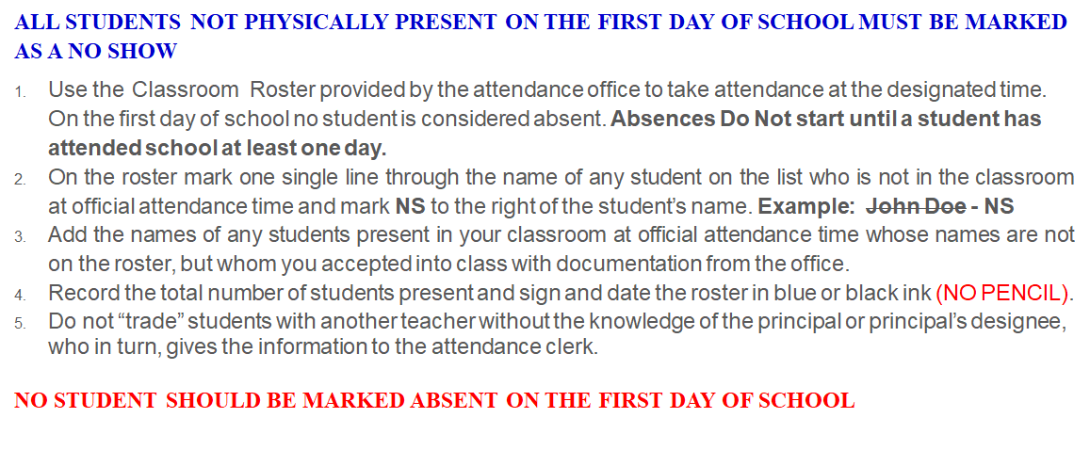
No Show Procedures for the Classroom Teacher

Slide 28
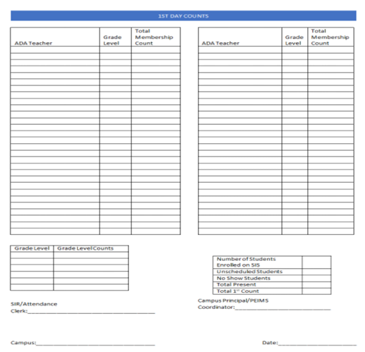
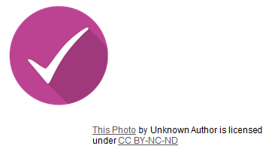
1st Day Counts Signature Form

Slide 29
Second Day Procedures
Teachers begin taking attendance in HISD Connect on Day 2.
Log into HISD Connect to Report Manual Membership Figures by 10:30 am.
Reminder:
If a student who was marked on the 1st day as a "No Show" reports on the 2nd day or thereafter,
Elementary Schools the No Show will remain, and a new enrollment line must be created for the new enrollment date.
Secondary campuses must reconcile all No-Show status for grades 7 – 12 and create a new enrollment line with the new enrollment date.

Slide 30
Second Day Procedures for Teachers
On the second day of school and any day thereafter, a student entering a teacher’s classroom must have documentation from the office (ex. Admit slip or class schedule). Verify that the student’s name is in HISD Connect the day the student enters class and, if not, notify the attendance clerk by e-mail.
Take attendance at the official ADA time.
Submit attendance in HISD Connect each day no later than 20 minutes after designated time of attendance.
Notify the attendance clerk in writing by using the Attendance Correction Form found on the FSC website or by e-mail of any absence corrections needed. Include student’s full legal name, local ID number and grade level in email. Attendance needs to be submitted, even if a class has 100 percent attendance.

Slide 31
Manual Official Attendance Documents
All manual official attendance documents (Absentee Slips) must meet these conditions:
(This also applies when a teacher cannot log into HISD Connect or there is a substitute in the teacher’s classroom.)
always use blue or black ink (never record manual entries in pencil, use liquid correction fluid, and never use a signature stamp);
always use the legal names of the students (no nicknames or shortened version of the name);
always use the correct student ID number;
Teacher or Substitute Teacher’s Signature in ink;
If errors are made on any official attendance document, strike one line through the error, enter corrections nearby, and initial in ink.

Slide 32
Membership Reporting Beginning 8-22-2022
Beginning the week of 8/22/2022. Authorized staff will log in to the HISD Connect by 10:30 am for elementary and secondary campuses.
Click on Membership under Functions in HISD Connect to access the system.
Please refer to the ASM to Principals about Membership Figures for the School Year 2022-2023 for all dates on membership reporting.
A primary user and an alternate should be designated by the principal for inputting data, but the user must have the Attendance Role in HISD Connect.

Slide 33
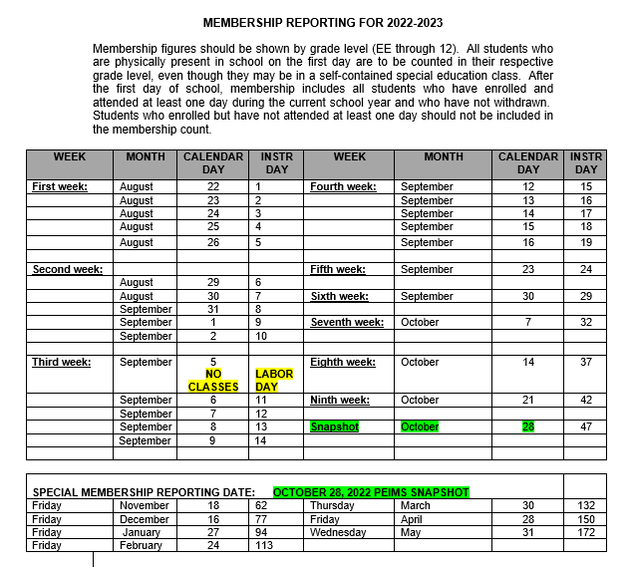
MEMBERSHIP REPORTING FOR 2022-2023

Slide 34
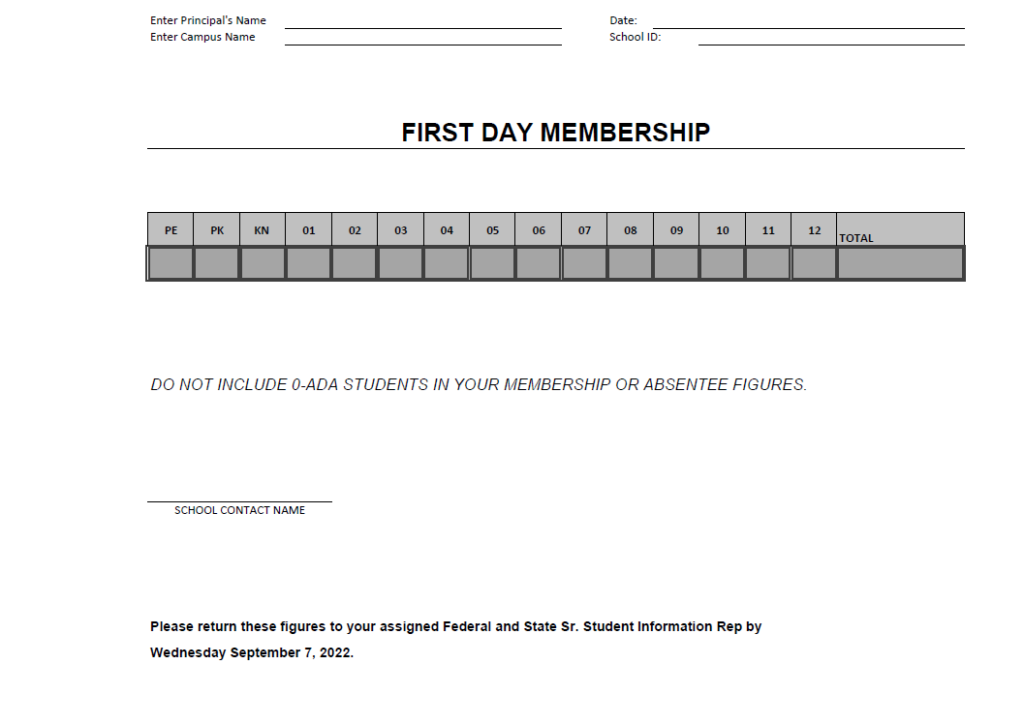
First Day Membership Form

Slide 35
End of Year Documentation
The manual ADA records listed below are required for TEA auditing purposes for the school year 2022-2023. Storage boxes may be ordered from the Central Warehouse or Office Depot. Heavy Duty Storage Boxes must be used. Labels are provided by FSC for the boxes.
Please follow the directions on preparing and packaging the records so that they can be quickly retrieved from the HISD storage facility when audited.
The following documents are to be placed in LETTER size re-sealable envelopes or bundled with sentence strips, labeled by cycle, with campus number, school name, school year and document name:
Any documentation submitted to the Attendance Office for input into HISD Connect for the ADA period, i.e., Absentee Reports (Manual Class Rosters from Teachers), Substitute Rosters – Signed and Dated in Ink, e-mails (any email a teacher sent to enter or correct attendance for students.
ADA attendance change forms which have been posted in HISD Connect with documentation attached (signed and dated in ink)
Education Organization Calendar Verification Report from HISD Connect
Membership Transaction Log – Cycles 1 through 6
Student Entry/Exit Summary Report
Original Copies of Six Weeks Verification Reports and Signature Pages
Original Copies of Student Enrollment/Membership Reconciliation

Slide 36
Federal and State Compliance Elementary & Secondary Data Information
Latonya Smith,
Senior Compliance Analyst

Slide 37
PEIMS
Important Fall Dates
- Close of school-start window – September 30, 2022
What is the "School Start Window"?
The "School Start Window" is from the first day of school through the last Friday of September. It has been designated by TEA as the timeframe we are allowed to account for all students in grades 7-12 who attended Houston ISD last school year and may or may not have returned this school year. Students who did not leave the Texas Education System and did not enroll in another Texas Public School District must be reported as dropouts if they are not located and enrolled before the last day of the "School Start Window".

Slide 38
PEIMS
Important Fall Dates - Continued
PEIMS Leaver Training
Fall and Summer PEIMS Training
PEIMS Discipline Training
See training schedule included
- Snapshot Date – Last Friday in October – October 28, 2022

Slide 39
ENROLLMENT
Verification of Address – use on-line School Zone Search Tool
Birth Certificate (preferred but not required) or proof of identity
statement of the child’s date of birth issued for school admission purposes by the division of the Texas Department of State Health Services responsible for vital statistics
Driver’s license
Passport
School ID card, records, or report card
Military ID
Hospital birth record
Adoption records
Church baptismal record
Any other legal document that establishes identity
Immunizations
30-day provisional enrollment for student transferring from another district; or
Student with 1st series completing next required doses as rapidly as is medically feasible

Slide 40
ENROLLMENT
A student who is homeless as defined by the McKinney-Vento Homeless Education Act shall be admitted into HISD
Student Residency Questionnaire (homeless) Foster Care Required Info
Home Language Survey

Slide 41
ENROLLMENT
Verify if student has local ID number in HISD Connect
Access TSDS Unique ID to check to see if the student is listed in the Unique ID Database and to make sure the correct Unique ID number is used.
Essential when enrolling student from out of district
Helps avoid TSDS Unique ID discrepancies

Slide 42
Online Enrollment Verification Steps
Below you will find a listing of high-level summary verification steps that will be required in efforts to ensure we are delivering accurate student information.

Slide 43
ENROLLMENT
Opening of School Reminders
- Thorough District Search in HISD Connect and TSDS Unique ID
- ADA Eligibility Code
Please ensure that Kinder students are changed from an ADA eligibility code 2 to 1
- Transfer Exception Reason
- Students Released by FSC through FSC@houstonisd.org from 8/11/2022 until 08/22/2022

Slide 44
Attendance and Membership Updates

Slide 45
Membership Reconciliation
Student membership from the teacher’s roster is to be reconciled to the attendance accounting records at the end of the first and fourth six-week reporting periods. The reconciliation is to verify that all students are reported on attendance records and that “no show” students have been purged from the attendance accounting system. District personnel has developed a form to be used at the end of the first and fourth six-week reporting periods to show the total number of students in membership in each teacher’s class during the official attendance period (See Appendix ). The total number of students in membership is to be reconciled to the total number of students listed in attendance accounting records. The district PEIMS coordinator and his or her supervisor must certify this document with their signatures. If your district uses a paperless attendance accounting system, the electronic equivalent of a signature page (for example, a feature that allows certifiers to indicate their certification of data electronically) is acceptable in lieu of a paper signature page. The reconciliation does not need to be conducted on the last day of the six-week reporting period. However, it should be conducted no later than the final week of the six-week period. The reconciliation should be for the official attendance period (usually second period).

Slide 46
Two New Attendance Codes
A student not actually on campus at the time attendance is taken may be considered in attendance for FSP (Funding) purposes if the student: Note: The following codes require documentation that has signed and dated by the principal or principal’s designee. | Description | Short Code in HISD Connect
misses school for the purpose of visiting a driver’s license office to obtain a driver’s license or learner permit. The student must be enrolled in high school and 15 years of age or older. Your district may not excuse the student for more than one day of school during the period the student is enrolled in high school for each purpose (obtaining a driver’s license and obtaining a learner license). Your district must verify the student’s visit to the driver’s license office in accordance with the procedures adopted by your district. | Driver’s License | DL
is absent as the result of a serious or life-threatening illness or related treatment that makes the student’s attendance infeasible. Documentation from a health care professional licensed, certified, or registered to practice in Texas must be provided that specifies the student’s illness and the anticipated period of the student’s absence relating to the illness or related treatment. A student with a mental health or substance abuse condition who is being treated for a serious illness (TEC, §25.087(b)(3)) in an outpatient day treatment program or partial hospitalization program, under the care of a health care professional licensed, certified, or registered to practice in Texas, shall be excused for the authorized treatment period, and shall not be withdrawn from school. The discharge summary from the outpatient day treatment or partial hospitalization program must include treatment admission and discharge dates to be provided to the school by the family upon return to school as documentation to excuse absences for the duration of the authorized outpatient treatment plan or partial hospitalization. | Under Doctor’s Care | UDC

Slide 47
CAMPUS PEIMS COORDINATORS
Craig Zeno,
Senior Compliance Analyst

Slide 48
Campus Non-Instructional Team
Campus PEIMS Coordinator– Assistant Principal
Campus Master Scheduler/Student Scheduler
Professional Registrar (Secondary Only)
Student Information Representative(SIR)
Attendance Clerk (All)
Student Behavior Coordinator
Lead Discipline Data Entry (All)
Special Populations Coordinators
Every campus must have an identified Non-Instructional team.
This team should meet at least once a month to review campus data and be responsible for supporting the 6-week reconciliation report.

Slide 49
Campus PEIMS Coordinator
Attend scheduled trainings and meetings related to PEIMS program areas. Consult with the Federal State and Compliance Analyst to schedule appropriate training for campus personnel.
Collaborate with the principal to designate campus contacts for each data type that impacts, funding, compliance, and accreditation as well as contacts who are responsible for special program content knowledge.
Identify, document and supply data reporting timelines and procedures to all personnel affected by them.
Keep principal informed as to the accountability and accuracy of all PEIMS data.
Oversee the reasonableness and accuracy of data by implementing procedures at the campus to ensure the data that affects funding, compliance, or accreditation is complete and correct by identifying areas of concern and determining corrective action.
Work cooperatively with other campus personnel to collect, organize, and format data required for submitting campus PEIMS information in a timely manner.
Responsibilities:

Slide 50
Six Weeks Data Verification
Campuses and Departments will be required to reconcile their data at the close of each six weeks cycle:
At the end of each 6-weeks cycle, campuses will be given a 5-day window to correct or enter any data elements.
Campus PEIMS Coordinators will work with their non-instructional team to ensure the reconciliation process is complete.
Campus Principal /Designee will sign-off on Campus Summary Report.

Slide 51
Six Weeks Data Verification
Campus Summary Reports must be generated each 6-week reporting period and reviewed by the Principal or designee for reasonableness. The Principal or Designee should do the following
Scrutinize regular attendance totals and special program attendance totals based on approximate membership,
Investigate all data totals that have exceptionally high value or a value of zero, and
Compare current-year totals to prior year totals to detect unreasonable differences

Slide 52
Six Week Data Verification
Campuses and Departments will be required to reconcile their data at the close of each six weeks cycle:
At the end of each 6-weeks cycle, campuses will be given a 5-day window to correct or enter any data elements.
Campus PEIMS Coordinators will work with their non-instructional team to ensure the reconciliation process is complete.
Campus Principal /Designee will sign-off on Campus Summary Report.

Slide 53
Data Verification Timelines
Cycle | Attendance Cycle Dates | Data Reconciliation Period | Campus Summary Report | Campus Summary/Signature & Acknowledgment Due to FSC
1 | Aug 22-Sept 30 | Oct 3 – Oct 7 | Oct 10 | October 14, 2022
2 | Oct 3-Nov 11 | Nov 14 – Nov 18 | Nov 28 | December 2, 2022
3 | Nov 14- Jan 13 | Jan 17 – Jan 20 | Jan 23 | January 27, 2023
4 | Jan 16-Feb 24 | Feb 27 – Mar 3 | Mar 6 | March 10, 2023
5 | Feb 27-April 14 | Apr 17 – Apr 20 | Apr 24 | April 28, 2023
6 | April 10- May 31 | May 15 – May 19 | May 22 | May 26, 2023

Slide 54
Federal and State Compliance Compliance Monitoring Information – Discipline
Latonya Smith, Senior Compliance Analyst

Slide 55
Compliance Reviews
The Compliance Monitoring team conducts the following review:
Discipline Records (folders with PEIMS mandatory placement events)
Resources on the FSC website:
PEIMS Appendix E
Code of Student Conduct
Discipline Review Preparation Guide
Discipline Action Codes Consequence Chart
Student Discipline Reason Code
DAEP/JJAEP Forms and Documents
HISD Discipline Referral Template
Discipline Change Form
Parent Notification Letters

Slide 56
SUSPENSION OF STUDENTS ENROLLED IN A GRADE LEVEL BELOW 3
A student who is enrolled in a grade level below grade 3 may not be placed in out-of-school suspension unless while on school property or while attending a school-sponsored or school-related activity on or off of school property, the student engages in:
Conduct that contains the elements of an offense related to weapons under Penal Code 46.02 or 46.05;
Conduct that contains the elements of a violent offense related under Penal Code 22.01, 22.011, 22.02, 22.021; or
Selling, giving, or delivering to another person or possessing, using, or being under the influence of any amount of:
Marihuana or a controlled substance, as defined by Health and Safety Code Chapter 481, or by 21 U.S.C. Section 801 et seq.;
A dangerous drug, as defined by Health and Safety Code Chapter 483; or
An alcoholic beverage, as defined by Alcoholic Beverage Code 1.04.

Slide 57
Discipline Referral Form
Student Demographic Information
Reason for referral
Incident Date – Date incident occurred
HISD Connect Incident number
PEIMS Reason / Action Coding
Days/Dates assigned
Administrator’s signature
Blue/black Ink ONLY
No signature stamps

Slide 58
Discipline Change Form

Slide 59
Discipline Folders – Required Documents
1. Discipline Referral
REQUIRED for Every Student that is REMOVED from his/her instructional setting.
All referral forms must include: student demographic information, description of incident, HISD Connect incident number, PEIMS Reason and Action codes, days and dates assigned for consequences, campus of accountability, campus of assignment, police incident number (if applicable to offense), and administrator’s signature and date (ink only).
AND
2. Supporting documentation as outlined below:
In-School Suspension (ISS)
Parent Notification Letter - signed and dated by an administrator. (See letters on the Federal and State Compliance website.)
Out of School Suspension (OSS)
Parent Notification Letter - signed and dated by an administrator. (See letters on the Federal and State Compliance website.)
District Alternative Education Program (DAEP)
DAEP Parent Notification Letter. (See letters on Student Discipline website.)
Juvenile Justice Alternative Education Program (JJAEP)
JJAEP Parent Notification Letter(s). (See letters on Student Discipline website.)
Copy of approval/rejection email from the DAEP administrator.
Copy of Online DAEP Referral Application.
Copy of Online JJAEP Referral Application.

Slide 60
DAEP Folder Content – Required Documents
Referral Form
Student demographics, reason for referral, incident date, incident number, PEIMS reason, PEIMS action , date action assigned, days assigned, administrator signature and date. Blue/black ink ONLY
Parent Notification Letter
In-School Suspension - parent name, student name, dates/days according to suspension, level of misconduct, administrator signature and date.
Out of School Suspension - parent name, student name, dates/days according to suspension, level of misconduct, administrator signature and date.
Notice of DAEP Assignment
Parent letter notifying parent of placement.
DAEP Online Form
Must be obtained from administrator entering in DAEP Online module.
DAEP Approval/rejection email
Email must be obtained from administrator.
Blue/black ink – ONLY

Slide 61
JJAEP Folder Content – Required Documents
Referral Form
Student demographics, reason for referral, incident date, incident number, PEIMS reason, PEIMS action , date action assigned, days assigned, administrator signature and date. Blue/black ink ONLY
Parent Notification Letter
In-School Suspension - parent name, student name, dates/days according to suspension, level of misconduct, administrator signature and date.
Out of School Suspension - parent name, student name, dates/days according to suspension, level of misconduct, administrator signature and date.
JJAEP Expulsion Letter
Parent letter notifying parent of placement.
JJAEP Email - approval/rejection
Email must be obtained from administrator.
Special Education Scholar
MDR’s findings and signature page
Student Victims
Copy of letter must be on file with appropriate signatures. Separate folder.

Slide 62
Discipline Open Labs
Objectives
Register on OneSource
PowerSchool input
Correcting errors on Certify and TSDS PEIMS
Discipline folder content
Audience
Campus personnel responsible for discipline.
Open Lab dates
Friday, September 2 – 9AM – noon
Friday, September 16 – 9AM - noon

Slide 63
Federal and State Compliance Monitoring Information – Leavers
Craig Zeno,
Senior Compliance Analyst

Slide 64
Leavers Information
Coding
Leaver coding is assigned by the campus principal or administrative designee. Campus clerks and/or SIRs do not assign leaver codes.
Close of the School Start Window
September 30, 2022 – The "School Start Window" is from the first day of school through the last Friday of September. It has been designated by TEA as the timeframe we are allowed to account for all students in grades 7-12 who attended Houston ISD last school year and may or may not have returned this school year. Students who did not leave the Texas Education System and did not enroll in another Texas Public School District must be reported as dropouts if they are not located and enrolled before the last day of the "School Start Window".
PEIMS Leaver Training
September 21, 2022 – HELC (OneSource)
Fall PEIMS Submission Timeline
Fall PEIMS First Submission Deadline, December 8, 2022 (Campus data entry deadline will be a few weeks prior to this date)
Fall PEIMS Resubmission Deadline (no leaver code changes can be made after the Fall PEIMS Resubmission deadline), January 19, 2023 (Campus data entry deadline will be a few weeks prior to this date)
Supporting documentation
Documentation must be sufficient to meet the assigned code. See PEIMS Appendix D for guidelines. Contact Federal and State Compliance with questions.
Documentation must be physically present in student’s folder at time of leaver code assignment.

Slide 65
Leaver Folders– Required Documents
Districts must document the withdrawal of students and maintain on file the appropriate paperwork associated with student withdrawals.
FSC conducts leaver reviews each fall. Every student leaver folder – including folders for students who leave during the summer – must have the leaver documentation. Each student leaver must have an individual folder.
District-Approved Leaver Form(s)
Exit Information/Leaver Code Assignment Form (Revised in 2021-2022)
Leaver Code Change Form (Revised in 2021-2022)
Home School Questionnaire
Oral Statement Form
CPS/L66 Form
Supporting Documentation
Authentic documentation for the assigned leaver code.
Sufficient documentation per TWEDS-Enabled Data Standards.
Supporting documentation
Documentation must be sufficient to meet the assigned code. See PEIMS Appendix D for guidelines. Contact Federal and State Compliance with questions.
Documentation must be physically present in student’s folder at time of leaver code assignment.

Slide 66
Leaver Documentation – General Guidelines
Signatures on Documentation
Documentation must be signed and dated by an authorized representative of the district.
Forms must be completed in BLUE/BLACK ink with all required information AND signed by the administrator in charge of leavers or the campus principal. NO COPIES OF SIGNATURES OR SIGNATURE STAMPS.
An original signature is not required on withdrawal forms received in the district by fax. Withdrawal forms received by e-mail DO NOT need to be signed by the parent/guardian or qualified student.
Written documentation of oral statements made in person or by telephone by the parent/guardian or qualified student is acceptable in SOME situations if it is signed and dated by the district representative.
Evaluation of Documentation
Merits of leaver documentation are assessed at the time the documentation is requested during a data inquiry investigation.
Determination of the acceptability of the documentation is made by the professional staff conducting the investigation.
Completeness of Documentation
Withdrawal documentation shall be considered INCOMPLETE without a date, signature, and destination.
Changing Leaver – Reason Codes
Merits of leaver documentation are assessed at the time the documentation is requested during a data inquiry investigation.
Determination of the acceptability of the documentation is made by the professional staff conducting the investigation.

Slide 67
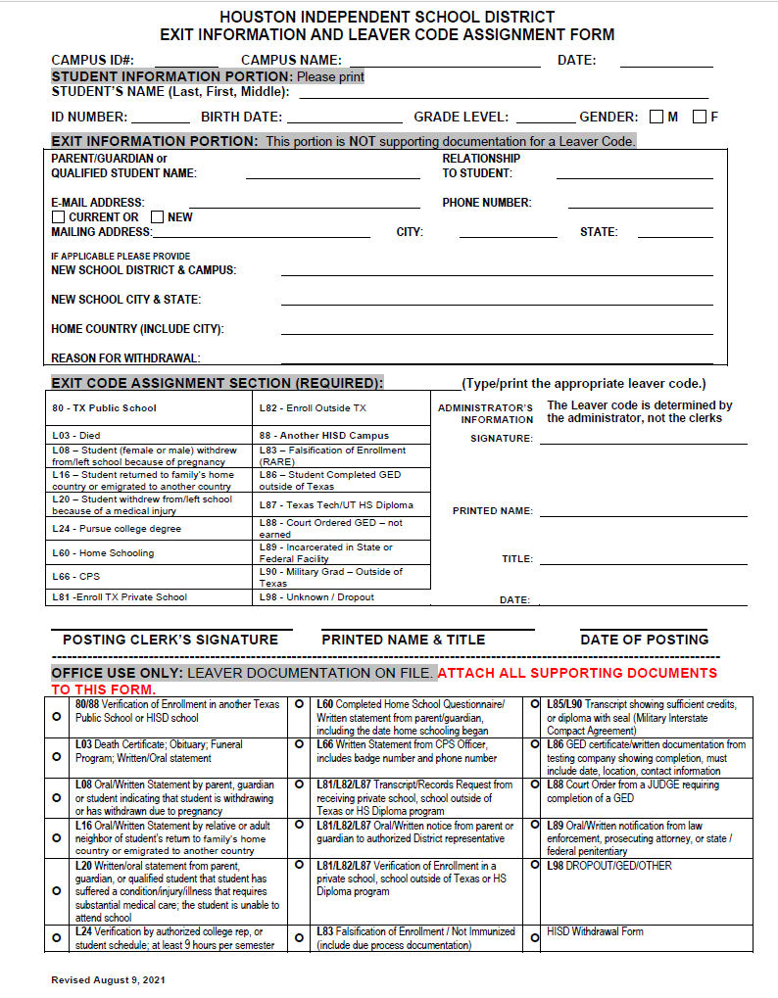
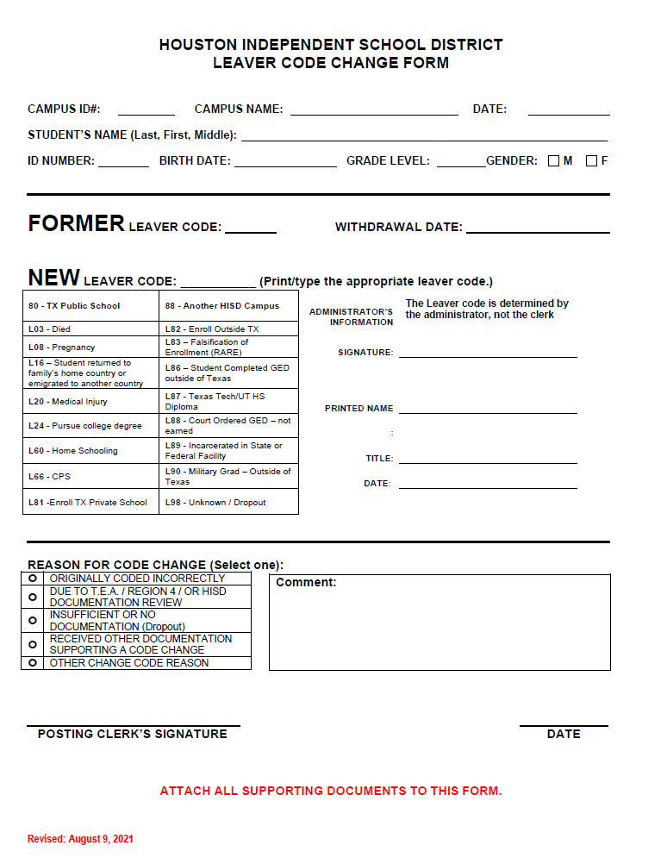
Leaver Forms – Required Documents
Supporting documentation
Documentation must be sufficient to meet the assigned code. See PEIMS Appendix D for guidelines. Contact Federal and State Compliance with questions.
Documentation must be physically present in student’s folder at time of leaver code assignment.

Slide 68
Leaver Compliance Reviews
Leaver Reviews
FSC will review campus leaver records for grades 7-12 each fall. More detailed information is in the 2022 – 2023 Federal/State Reporting and Attendance Procedures Manual.
The FSC Leaver Review Process
Before the Review
FSC contacts campus to schedule compliance review.
During the Review
FSC reviews leaver documents and completes the Leaver Audit Review and Leaver Review Summary Reports.
After the Review
FSC meets with campus leaver contacts to debrief the review and recommendations.
Follow-Up Process
FSC follows up with schools that have coding errors and with those that have non-compliant records.

Slide 69
Best Practices for Campus Leaver Contacts
Attend FSC PEIMS Leaver Training each year.
Use the district- approved forms from the Federal and State Compliance website. Download new forms each year.
Establish and implement a system for leaver coding and maintaining supporting documentation.
Read and follow guidance in TSDS Web-Enabled Data Standards (TWEDS). See handout with instructions for downloading the documents.
Review and following Best Practices in State/Reporting and Attendance Procedures Manual.
Review HISD Connect, OnDataSuite and TSDS Fall PEIMS First Submission reports for accuracy and reasonableness. Correct all data prior to the campus data entry deadline.
Contact your Federal and State Compliance representative with questions.

Slide 70
Leaver Resources
Federal and State Compliance, https://www.houstonisd.org/Page/58634
HISD School Guidelines
TSDS Web-Enabled Data Standards (TWEDS), https://tealprod.tea.state.tx.us/TWEDS/90/0/0/0/DataSubmission/TechnicalResources
TEA Student Attendance Accounting Handbook, https://tea.texas.gov/finance-and-grants/financial-compliance/student-attendance-accounting-handbook

Slide 71
Federal and State Compliance TSDS PEIMS UID/ET
Irma Hasnain
Sr. Manager

Slide 72
TSDS UNIQUE ID/ET Enrollment Tracking
A Unique ID is required for all students and staff members in order to load information into the Texas Student Data System (TSDS) Education Date Warehouse (EDW).
For a student to acquire a TSDS Unique ID, the student must have a Social Security Number or State Alternate Number, the Federal Race and Ethnic code/s.
In order to access the TSDS Unique Id system, you must electronically first set up a TEAL Account. Here is the link to get access https://pryor.tea.state.tx.us/ Select on Don’t have an account? Request New User Account.
Once TSDS Portal Account Access is established, log in to TEAL and select TSDS Portal. Here is the link to TEAL: https://pryor.tea.state.tx.us/
The instructions on acquiring TSDS Unique Search access is on the FSC Website under Request Access, here is the link https://www.houstonisd.org/Page/175782

Slide 73
Applications – TEXAS STUDENT DATA SYSTEM PORTAL (TSDS)
After setting up your TEAL account with access to the TSDS Portal, click the Texas Student Data System Portal link, this will take you to the Unique ID searches page.

Slide 74
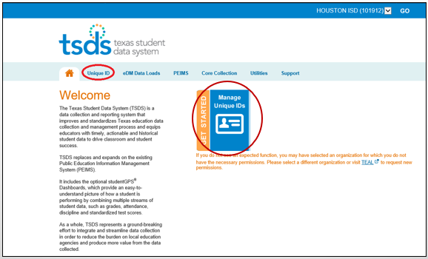
TSDS Portal Page
The TSDS Portal page appears select either: Unique ID Tab or the Manage Unique IDs icon

Slide 75
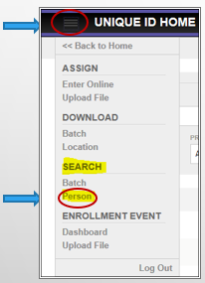
Person Search
Next to Unique ID Home, select the navigation bar (hamburger button)
In the menu you can search for a student by selecting Person under Search
From here you can view the student’s information

Slide 76
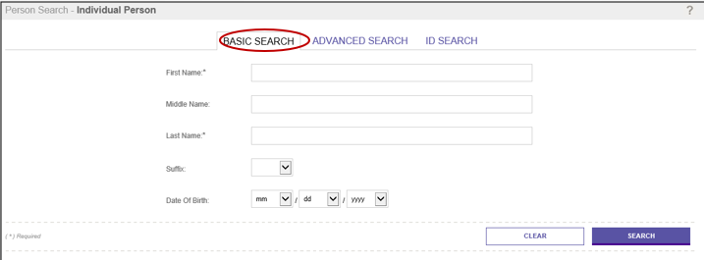
Student Search Options Basic Search
There are 3 options to perform a student search: Basic Search, Advanced Search and ID Search
The Basic Search option allows you to search for a person using basic demographic information
Note: First Name and Last Name are required for both the Basic Search and Advanced Search. Wild card characters (e.g.,*,%,_,?) are not supported.

Slide 77
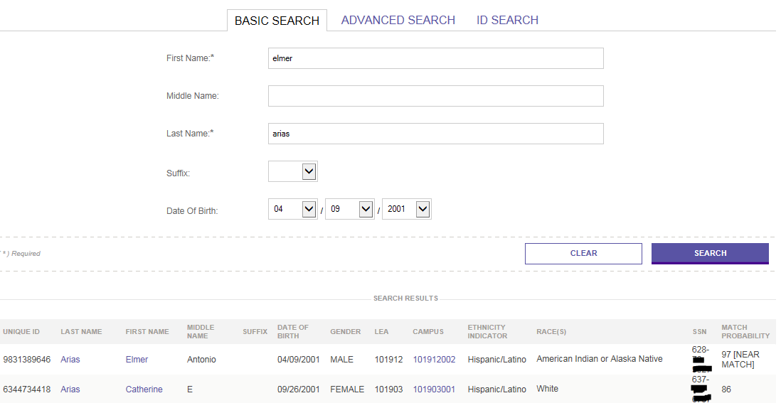
Basic Search Results
When one or more persons are found, the application displays the matching records in the Match Probability column. Select the student name you are looking for; this will take you to the Master Record tab.
Stu Info: UID, Name, DOB, Campus…

Slide 78
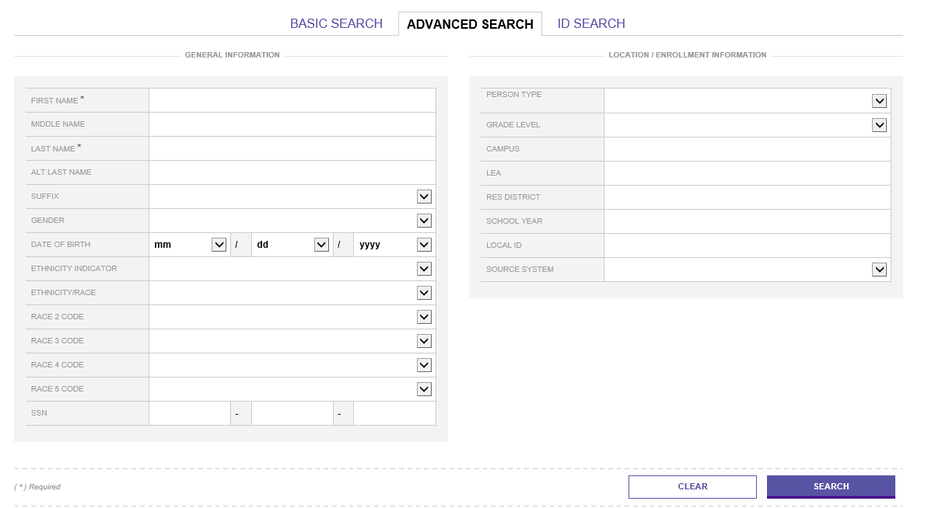
Advanced Search
Advanced Search allows you to search for a person using all available fields
Note: First Name and Last Name are required for both the Basic Search and Advanced Search. Wild card characters (e.g.,*,%,_,?) are not supported

Slide 79
ID Search
ID Search allows you to search for persons by Unique ID, Social Security Number SSN or Alias ID (district Local ID)
Enter search criteria. Pay special attention to required fields for the search type.
Click Search
Note: The application searches against the current information for persons who have been assigned an ID. Searching for person’s history information (e.g., previous school code) does not return results.

Slide 80
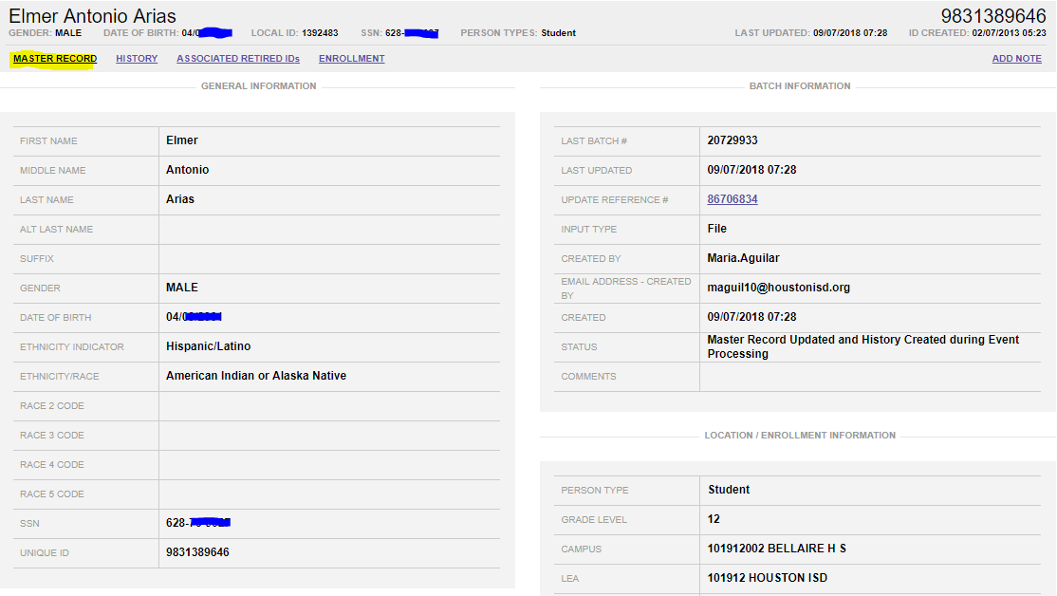
Master Record
Master Record holds the student demographics and location/enrollment information.
Student Unique ID

Slide 81
TSDS HISTORICAL ENROLLMENT
The historical enrollment data can be found on the History tab.
The PET data has been migrated into the TSDS UID system, the years that migrated are 2012-2013, 2013-2014, 2014-2015, 2015-2016, 2016-2017, 2017-2018, and 2018-2019.

Slide 82
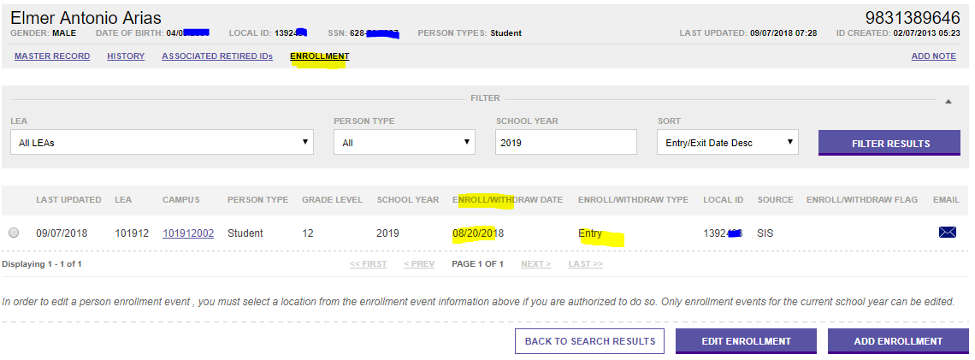
TSDS Enrollment Tracking
Campuses do not have edit capabilities and will need to contact their SSIR at FSC to add/delete enrollment entries, or enter exception reasons (Calendar, Verify) to a student’s enrollment screen.

Slide 83
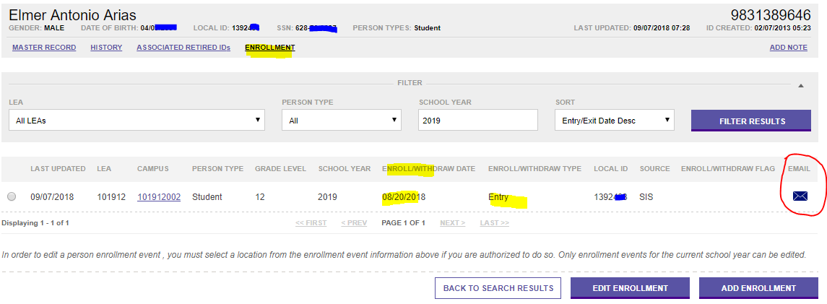
Email Functionality
Email capability will be available to assist with enrollment event resolution (Duplicate Enrollment).
Campuses can utilize this email function to contact other districts or campuses.
If campuses are sending student documents, they need to be encrypted to abide by the FERPA (Family Educational Rights and Privacy Act) laws.

Slide 84
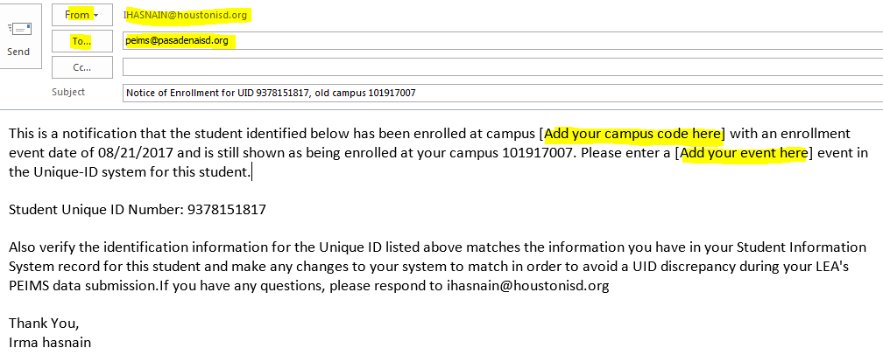
Sample Email
Email will show the users’ district email (not TEA’s PGP), the example below is a discrepancy between Houston ISD and Pasadena ISD.
Campus Add your campus code (campus number) and event.
Campus can also compose the email according to the request.

Slide 85
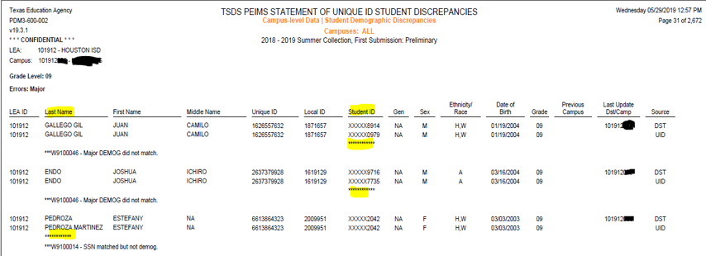
TSDS PEIMS Statement of Unique ID Student Discrepancy Report
Report is available during PEIMS submissions, campuses do not have the access to run this report, the FSC department will email report to the campus.
These errors occur when the student’s demographics on PowerSchool SIS and the TSDS Student UID do not match (both must match).
When documents are requested for a student, it is imperative that campuses submit copies of supporting documentation and include the discrepancy report.
When emailing student documents, please encrypt to abide by the FERPA (Family Educational Rights and Privacy Act) laws.

Slide 86
Presumed Duplicate Student Report (UID0-000-001)
Campuses do not have the access to run Enrollment Reports at this time.
TSDS UID Presumed Duplicate Student Report for Enrollment will be emailed from our office.
This report replaced the report PET Presumed Duplicate of Enrollment Report.
The Enroll/Withdraw Type codes of 01 & 02 indicate Enrolled (Entry): 01 and the Withdrawn (Exit): 02

Slide 87
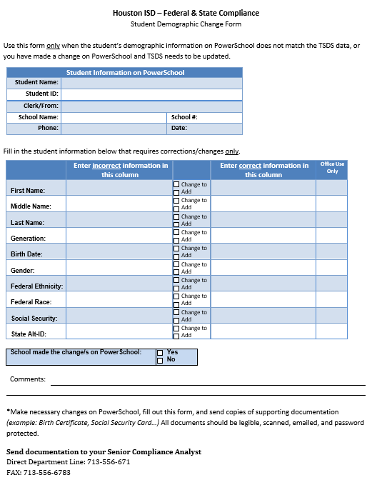
STUDENT DEMOGRAPHIC CORRECTIONS
The Student Demographic Change Form is used when a correction or a change is required on the student’s demographic/s.
Fill out the form and email copies of supporting documentation to your Senior Compliance Analyst.
Reminder, when sending student documents, please encrypt to abide by the FERPA (Family Educational Rights and Privacy Act) laws.

Slide 88
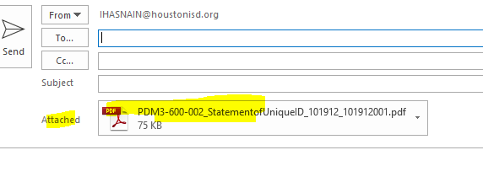
Sending Secure Documents
Campus must secure documents to comply with the family educational rights and privacy act (FERPA) regulations
Send documents to your FSC Senior Compliance Analyst
Here is one way to secure documents to comply with the family educational rights and privacy act (FERPA) regulations:
Attach document to an email.

Slide 89
Sending Secure Documents (Continued)
Open document/attachment – select file – properties

Slide 90
Sending Secure Documents (Continued)
Select Security tab – select password security - OK

Slide 91
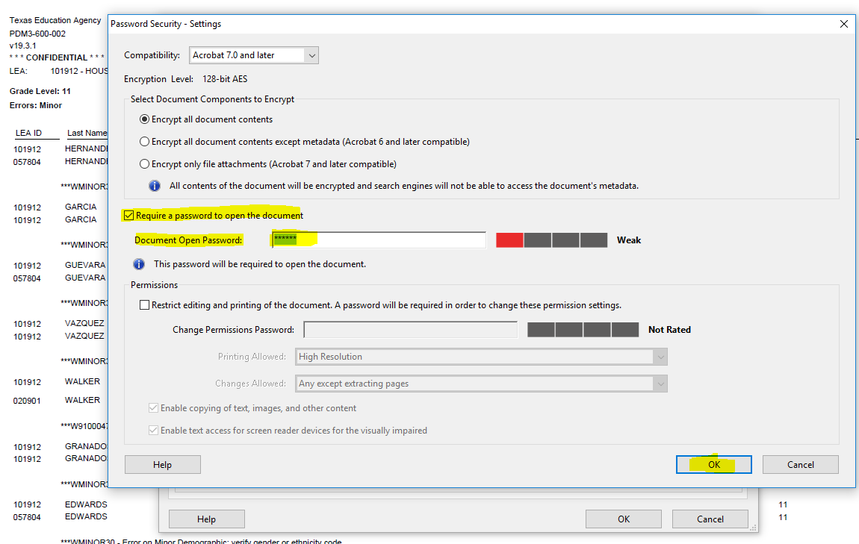
Sending Secure Documents (Continued)
Check on Require a password to open the document – on Document open password: **enter a password** > select - OK
Example of a password: HISD#1

Slide 92
Sending Secure Documents (Continued)
Document open password: **Enter same password again** select > OK
Check Do not show this message again > OK

Slide 93
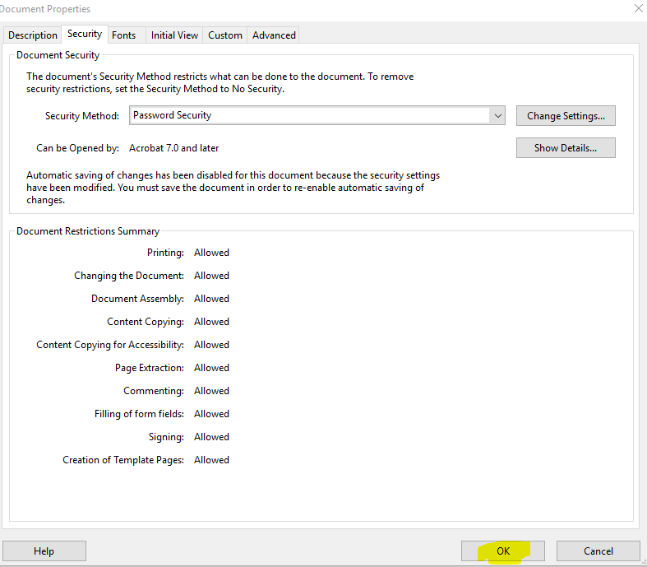
Sending Secure Documents (Continued)
Original window appears again: select OK – make sure you send the password to the person you are sending documents on a separate email. (Example of a password: HISD#1)

Slide 94
Trainings, Labs & Questions
Training: TSDS Unique ID/ ET (Enrollment Tracking) Monthly
Labs: TSDS UID/ET coming soon
If you have any questions or concerns, please contact your State Reporting SSIR – Rose Gamboa, Student Information and Reporting Analyst - Sylvia Guerrero, or Sr. Manager, State Reporting - Irma Hasnain.

Slide 95
Thank you

